Slide 1
Regression Models for Biostatistics 1 (RM1)
Prof. Armando Teixeira-Pinto

Slide 2
Learning outcomes
Describe the different motivations for regression modelling
Formulate a simple linear regression model
Understand the least squares method of parameter estimation and its equivalence to maximum likelihood
Interpret statistical output for a simple linear regression model
Calculate and interpret confidence intervals and prediction intervals for simple linear regression
Notes:
Hello and welcome to a lecture for regression modelling for biostatistics 1. I am Tim Schlub, from the University of Sydney.
In this lecture we will:
1. Describe the different motivations for regression modelling
2. Formulate a simple linear regression model
And
3. Understand the least squares method of parameter estimation and its equivalence to maximum likelihood
The final two learning objectives of this week will be covered in the second recorded video.

Slide 3

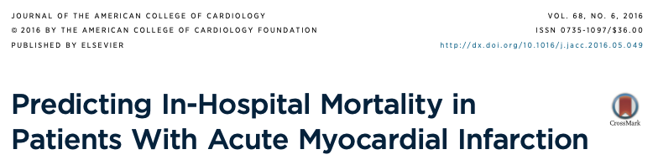
Prediction
Notes:
Discharge (Home vs rehabilitation)

Slide 4
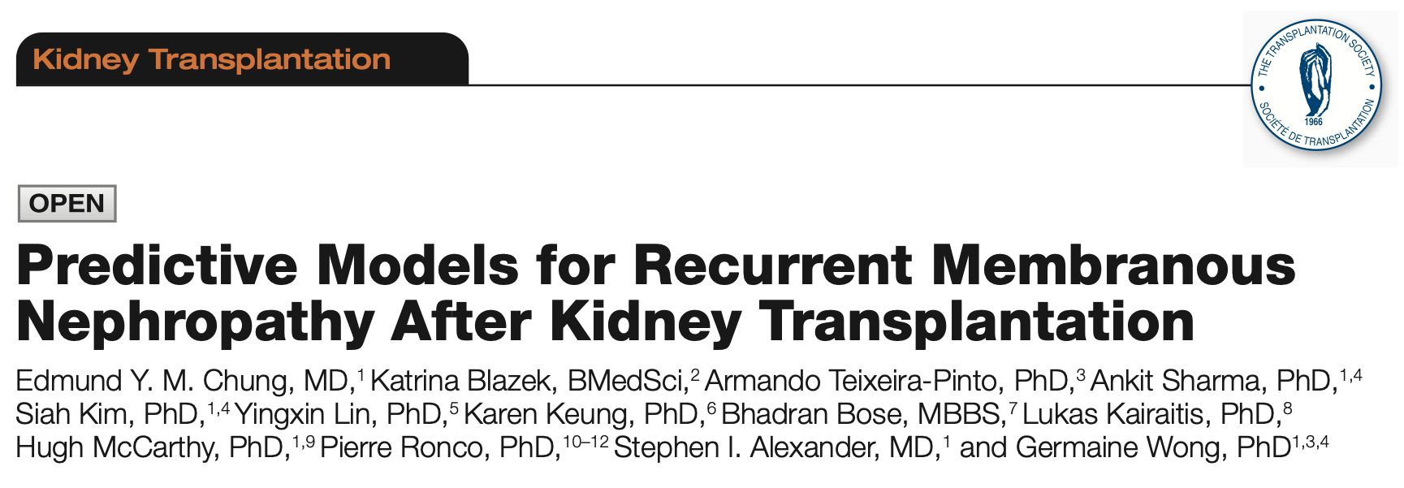
Prediction
Notes:
Discharge (Home vs rehabilitation)

Slide 5
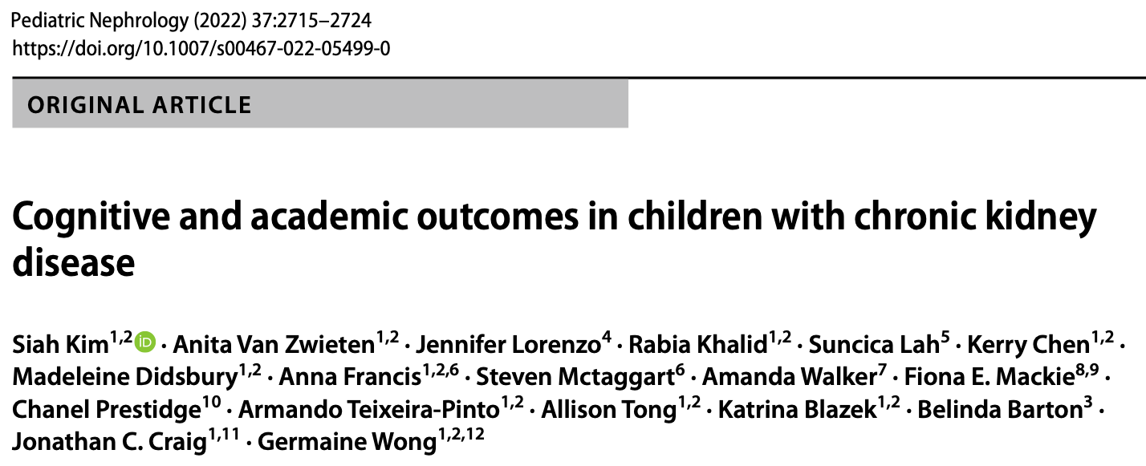
Isolating the effect of a single exposure
Confounder
Exposure
Outcome
Notes:
Discharge (Home vs rehabilitation)

Slide 6
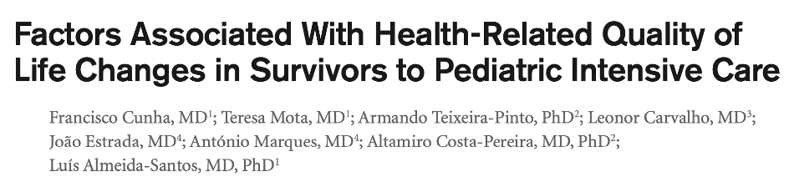
Studying multiple factors associated with the outcome
X₃
X₂
Y
X₁
X₅
X₄
Notes:
Discharge (Home vs rehabilitation)

Slide 7
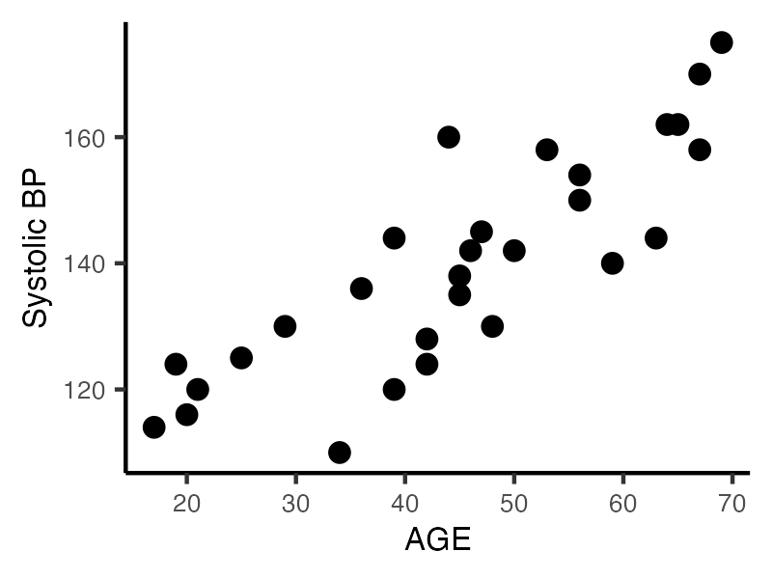
Simple linear regression
Notes:
The first of which is “simple linear regression”, where we have a continuous outcome, in this case systolic blood pressure, and a continuous covariate in this case age. As this relationship looks fairly linear, or straight, we can describe it with the equation of a line shown. The equation has two parameters beta 0 and beta 1. Beta 0 is the intercept, where the line crosses the y-axis, which here would be interpreted as the mean blood pressure when age equals zero years. Not a particularly useful interpretation, and so we commonly ignore the value of the intercept Beta 0.
Beta 1 on the other hand is the slope, which equals the mean increase in blood pressure for every year increase in age. This interpretation is extremely helpful, as it describes how blood pressure changes with age.

Slide 8
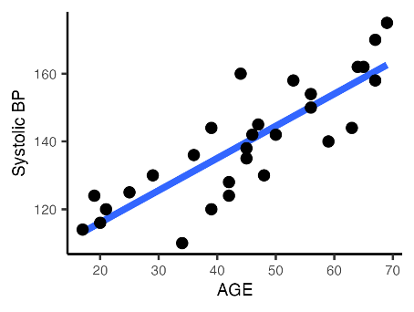
Simple linear regression
Notes:
The first of which is “simple linear regression”, where we have a continuous outcome, in this case systolic blood pressure, and a continuous covariate in this case age. As this relationship looks fairly linear, or straight, we can describe it with the equation of a line shown. The equation has two parameters beta 0 and beta 1. Beta 0 is the intercept, where the line crosses the y-axis, which here would be interpreted as the mean blood pressure when age equals zero years. Not a particularly useful interpretation, and so we commonly ignore the value of the intercept Beta 0.
Beta 1 on the other hand is the slope, which equals the mean increase in blood pressure for every year increase in age. This interpretation is extremely helpful, as it describes how blood pressure changes with age.

Slide 9
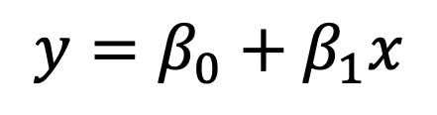
Simple linear regression
$$y=β_{0}+β_{1}x$$
Notes:
The first of which is “simple linear regression”, where we have a continuous outcome, in this case systolic blood pressure, and a continuous covariate in this case age. As this relationship looks fairly linear, or straight, we can describe it with the equation of a line shown. The equation has two parameters beta 0 and beta 1. Beta 0 is the intercept, where the line crosses the y-axis, which here would be interpreted as the mean blood pressure when age equals zero years. Not a particularly useful interpretation, and so we commonly ignore the value of the intercept Beta 0.
Beta 1 on the other hand is the slope, which equals the mean increase in blood pressure for every year increase in age. This interpretation is extremely helpful, as it describes how blood pressure changes with age.

Slide 10
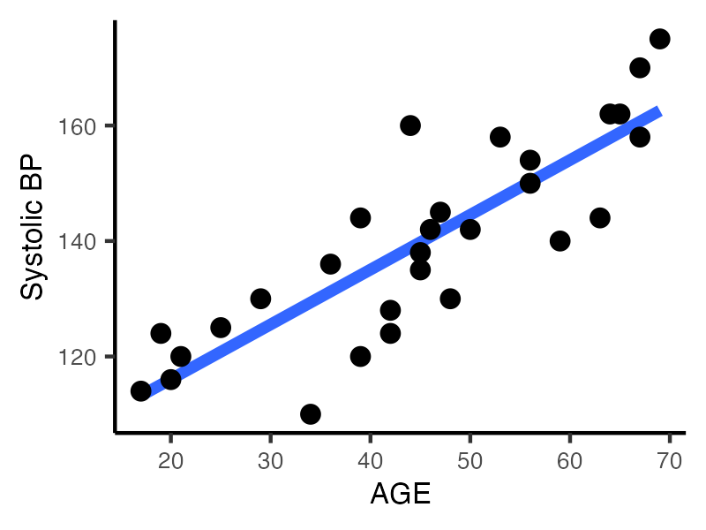
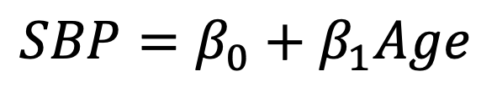
Simple linear regression
$$SBP=β_{0}+β_{1}Age$$
Notes:
The first of which is “simple linear regression”, where we have a continuous outcome, in this case systolic blood pressure, and a continuous covariate in this case age. As this relationship looks fairly linear, or straight, we can describe it with the equation of a line shown. The equation has two parameters beta 0 and beta 1. Beta 0 is the intercept, where the line crosses the y-axis, which here would be interpreted as the mean blood pressure when age equals zero years. Not a particularly useful interpretation, and so we commonly ignore the value of the intercept Beta 0.
Beta 1 on the other hand is the slope, which equals the mean increase in blood pressure for every year increase in age. This interpretation is extremely helpful, as it describes how blood pressure changes with age.

Slide 11
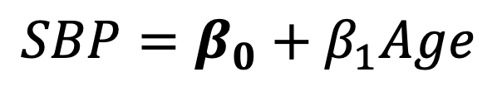

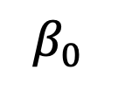
Simple linear regression
Systolic BP
$$SBP=β_{0}+β_{1}Age$$
$$β_{0}$$
$$0$$
Age
Notes:
The first of which is “simple linear regression”, where we have a continuous outcome, in this case systolic blood pressure, and a continuous covariate in this case age. As this relationship looks fairly linear, or straight, we can describe it with the equation of a line shown. The equation has two parameters beta 0 and beta 1. Beta 0 is the intercept, where the line crosses the y-axis, which here would be interpreted as the mean blood pressure when age equals zero years. Not a particularly useful interpretation, and so we commonly ignore the value of the intercept Beta 0.
Beta 1 on the other hand is the slope, which equals the mean increase in blood pressure for every year increase in age. This interpretation is extremely helpful, as it describes how blood pressure changes with age.

Slide 12
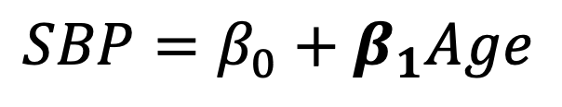

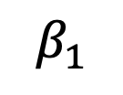
Simple linear regression
Systolic BP
$$SBP=β_{0}+β_{1}Age$$
$$β_{1}$$
$$1 yr$$
$$0$$
Age
Notes:
The first of which is “simple linear regression”, where we have a continuous outcome, in this case systolic blood pressure, and a continuous covariate in this case age. As this relationship looks fairly linear, or straight, we can describe it with the equation of a line shown. The equation has two parameters beta 0 and beta 1. Beta 0 is the intercept, where the line crosses the y-axis, which here would be interpreted as the mean blood pressure when age equals zero years. Not a particularly useful interpretation, and so we commonly ignore the value of the intercept Beta 0.
Beta 1 on the other hand is the slope, which equals the mean increase in blood pressure for every year increase in age. This interpretation is extremely helpful, as it describes how blood pressure changes with age.

Slide 13
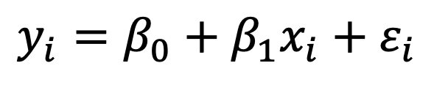
Simple linear regression
$$y_{i}=β_{0}+β_{1}x_{i}+ε_{i}$$
Notes:
The first of which is “simple linear regression”, where we have a continuous outcome, in this case systolic blood pressure, and a continuous covariate in this case age. As this relationship looks fairly linear, or straight, we can describe it with the equation of a line shown. The equation has two parameters beta 0 and beta 1. Beta 0 is the intercept, where the line crosses the y-axis, which here would be interpreted as the mean blood pressure when age equals zero years. Not a particularly useful interpretation, and so we commonly ignore the value of the intercept Beta 0.
Beta 1 on the other hand is the slope, which equals the mean increase in blood pressure for every year increase in age. This interpretation is extremely helpful, as it describes how blood pressure changes with age.

Slide 14
Simple linear regression
$$y_{i}=β_{0}+β_{1}x_{i}+ε_{i}$$
Notes:
The first of which is “simple linear regression”, where we have a continuous outcome, in this case systolic blood pressure, and a continuous covariate in this case age. As this relationship looks fairly linear, or straight, we can describe it with the equation of a line shown. The equation has two parameters beta 0 and beta 1. Beta 0 is the intercept, where the line crosses the y-axis, which here would be interpreted as the mean blood pressure when age equals zero years. Not a particularly useful interpretation, and so we commonly ignore the value of the intercept Beta 0.
Beta 1 on the other hand is the slope, which equals the mean increase in blood pressure for every year increase in age. This interpretation is extremely helpful, as it describes how blood pressure changes with age.

Slide 15
Simple linear regression
$$y_{i}=β_{0}+β_{1}x_{i}+ε_{i}$$
Notes:
The first of which is “simple linear regression”, where we have a continuous outcome, in this case systolic blood pressure, and a continuous covariate in this case age. As this relationship looks fairly linear, or straight, we can describe it with the equation of a line shown. The equation has two parameters beta 0 and beta 1. Beta 0 is the intercept, where the line crosses the y-axis, which here would be interpreted as the mean blood pressure when age equals zero years. Not a particularly useful interpretation, and so we commonly ignore the value of the intercept Beta 0.
Beta 1 on the other hand is the slope, which equals the mean increase in blood pressure for every year increase in age. This interpretation is extremely helpful, as it describes how blood pressure changes with age.

Slide 16

Simple linear regression
$$E(y_{i}|x_{i})$$
$$y_{i}=β_{0}+β_{1}x_{i}+ε_{i}$$
Notes:
The first of which is “simple linear regression”, where we have a continuous outcome, in this case systolic blood pressure, and a continuous covariate in this case age. As this relationship looks fairly linear, or straight, we can describe it with the equation of a line shown. The equation has two parameters beta 0 and beta 1. Beta 0 is the intercept, where the line crosses the y-axis, which here would be interpreted as the mean blood pressure when age equals zero years. Not a particularly useful interpretation, and so we commonly ignore the value of the intercept Beta 0.
Beta 1 on the other hand is the slope, which equals the mean increase in blood pressure for every year increase in age. This interpretation is extremely helpful, as it describes how blood pressure changes with age.

Slide 17
Simple linear regression
$$y_{i}=β_{0}+β_{1}x_{i}+ε_{i}$$
Notes:
The first of which is “simple linear regression”, where we have a continuous outcome, in this case systolic blood pressure, and a continuous covariate in this case age. As this relationship looks fairly linear, or straight, we can describe it with the equation of a line shown. The equation has two parameters beta 0 and beta 1. Beta 0 is the intercept, where the line crosses the y-axis, which here would be interpreted as the mean blood pressure when age equals zero years. Not a particularly useful interpretation, and so we commonly ignore the value of the intercept Beta 0.
Beta 1 on the other hand is the slope, which equals the mean increase in blood pressure for every year increase in age. This interpretation is extremely helpful, as it describes how blood pressure changes with age.

Slide 18

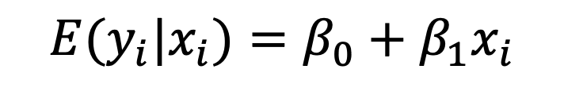
Simple linear regression
$$y_{i}=β_{0}+β_{1}x_{i}+ε_{i}$$
$${E(y}_{i}|x_{i})=β_{0}+β_{1}x_{i}$$
$$μ_{y|x}=β_{0}+β_{1}x_{i}$$
Notes:
The first of which is “simple linear regression”, where we have a continuous outcome, in this case systolic blood pressure, and a continuous covariate in this case age. As this relationship looks fairly linear, or straight, we can describe it with the equation of a line shown. The equation has two parameters beta 0 and beta 1. Beta 0 is the intercept, where the line crosses the y-axis, which here would be interpreted as the mean blood pressure when age equals zero years. Not a particularly useful interpretation, and so we commonly ignore the value of the intercept Beta 0.
Beta 1 on the other hand is the slope, which equals the mean increase in blood pressure for every year increase in age. This interpretation is extremely helpful, as it describes how blood pressure changes with age.

Slide 19
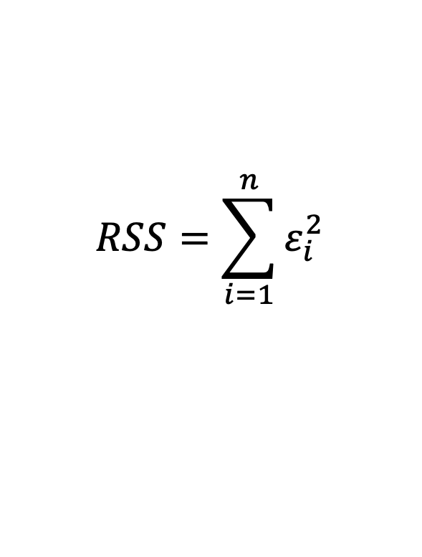
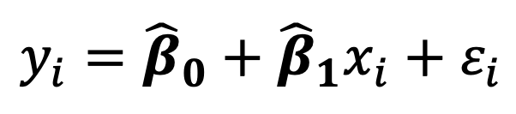
Simple linear regression
$$y_{i}={\hat{β}}_{0}+{\hat{β}}_{1}x_{i}+ε_{i}$$
$$RSS=\sum_{i=1}^{n}{ε_{i}^{2}}$$
Notes:
The first of which is “simple linear regression”, where we have a continuous outcome, in this case systolic blood pressure, and a continuous covariate in this case age. As this relationship looks fairly linear, or straight, we can describe it with the equation of a line shown. The equation has two parameters beta 0 and beta 1. Beta 0 is the intercept, where the line crosses the y-axis, which here would be interpreted as the mean blood pressure when age equals zero years. Not a particularly useful interpretation, and so we commonly ignore the value of the intercept Beta 0.
Beta 1 on the other hand is the slope, which equals the mean increase in blood pressure for every year increase in age. This interpretation is extremely helpful, as it describes how blood pressure changes with age.

Slide 20
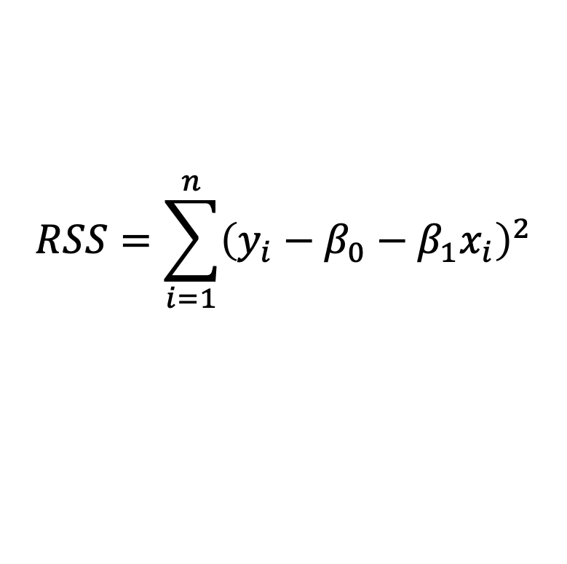
Simple linear regression
$$y_{i}={\hat{β}}_{0}+{\hat{β}}_{1}x_{i}+ε_{i}$$
$$RSS=\sum_{i=1}^{n}{{\left(y_{i}−β_{0}−β_{1}x_{i}\right)}^{2}}$$
Notes:
The first of which is “simple linear regression”, where we have a continuous outcome, in this case systolic blood pressure, and a continuous covariate in this case age. As this relationship looks fairly linear, or straight, we can describe it with the equation of a line shown. The equation has two parameters beta 0 and beta 1. Beta 0 is the intercept, where the line crosses the y-axis, which here would be interpreted as the mean blood pressure when age equals zero years. Not a particularly useful interpretation, and so we commonly ignore the value of the intercept Beta 0.
Beta 1 on the other hand is the slope, which equals the mean increase in blood pressure for every year increase in age. This interpretation is extremely helpful, as it describes how blood pressure changes with age.

Slide 21
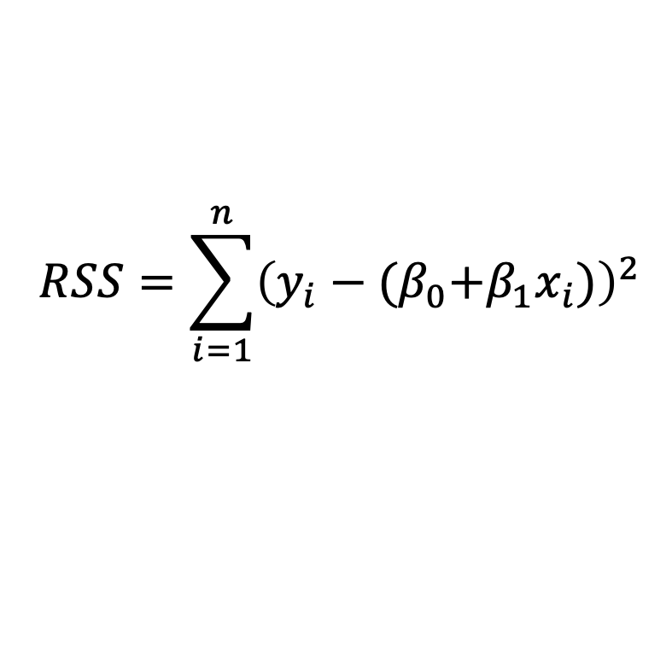
Simple linear regression
$$y_{i}={\hat{β}}_{0}+{\hat{β}}_{1}x_{i}+ε_{i}$$
$$RSS=\sum_{i=1}^{n}{{\left(y_{i}−{(β}_{0}+β_{1}x_{i})\right)}^{2}}$$
ORDINARY LEAST SQUARES (OLS)
Notes:
The first of which is “simple linear regression”, where we have a continuous outcome, in this case systolic blood pressure, and a continuous covariate in this case age. As this relationship looks fairly linear, or straight, we can describe it with the equation of a line shown. The equation has two parameters beta 0 and beta 1. Beta 0 is the intercept, where the line crosses the y-axis, which here would be interpreted as the mean blood pressure when age equals zero years. Not a particularly useful interpretation, and so we commonly ignore the value of the intercept Beta 0.
Beta 1 on the other hand is the slope, which equals the mean increase in blood pressure for every year increase in age. This interpretation is extremely helpful, as it describes how blood pressure changes with age.

Slide 22
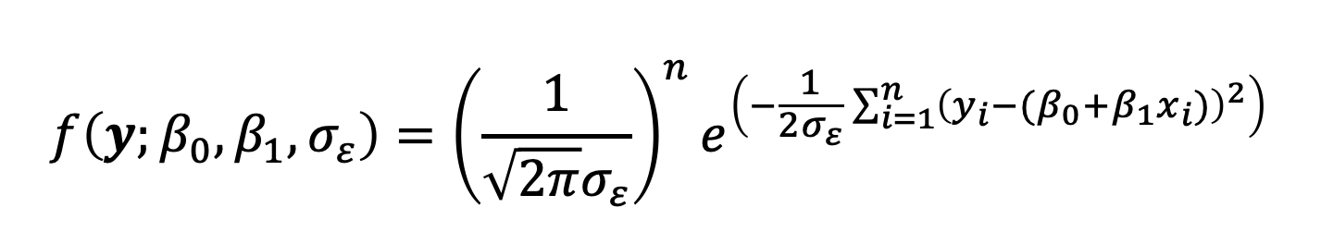

Simple linear regression
$$y_{i}={\hat{β}}_{0}+{\hat{β}}_{1}x_{i}+ε_{i}$$
$$ε_{i}\underset{i.i.d}{∼}{N(0, σ_{ε}) }$$
$$f\left(y;β_{0}, β_{1},σ_{ε}\right)={\left(\frac{1}{\sqrt{2π}σ_{ε}}\right)}^{n}e^{\left(−\frac{1}{2σ_{ε}}\sum_{i=1}^{n}{{\left(y_{i}−{(β}_{0}+β_{1}x_{i})\right)}^{2}}\right)}$$
Notes:
The first of which is “simple linear regression”, where we have a continuous outcome, in this case systolic blood pressure, and a continuous covariate in this case age. As this relationship looks fairly linear, or straight, we can describe it with the equation of a line shown. The equation has two parameters beta 0 and beta 1. Beta 0 is the intercept, where the line crosses the y-axis, which here would be interpreted as the mean blood pressure when age equals zero years. Not a particularly useful interpretation, and so we commonly ignore the value of the intercept Beta 0.
Beta 1 on the other hand is the slope, which equals the mean increase in blood pressure for every year increase in age. This interpretation is extremely helpful, as it describes how blood pressure changes with age.

Slide 23
Simple linear regression
$$y_{i}={\hat{β}}_{0}+{\hat{β}}_{1}x_{i}+ε_{i}$$
$$ε_{i}\underset{i.i.d}{∼}{N(0, σ_{ε}) }$$
$$f\left(y;β_{0}, β_{1},σ_{ε}\right)={\left(\frac{1}{\sqrt{2π}σ_{ε}}\right)}^{n}e^{\left(−\frac{1}{2σ_{ε}}\sum_{i=1}^{n}{{\left(y_{i}−{(β}_{0}+β_{1}x_{i})\right)}^{2}}\right)}$$
Notes:
The first of which is “simple linear regression”, where we have a continuous outcome, in this case systolic blood pressure, and a continuous covariate in this case age. As this relationship looks fairly linear, or straight, we can describe it with the equation of a line shown. The equation has two parameters beta 0 and beta 1. Beta 0 is the intercept, where the line crosses the y-axis, which here would be interpreted as the mean blood pressure when age equals zero years. Not a particularly useful interpretation, and so we commonly ignore the value of the intercept Beta 0.
Beta 1 on the other hand is the slope, which equals the mean increase in blood pressure for every year increase in age. This interpretation is extremely helpful, as it describes how blood pressure changes with age.

Slide 24
Simple linear regression
Observations are independent
Notes:
The first of which is “simple linear regression”, where we have a continuous outcome, in this case systolic blood pressure, and a continuous covariate in this case age. As this relationship looks fairly linear, or straight, we can describe it with the equation of a line shown. The equation has two parameters beta 0 and beta 1. Beta 0 is the intercept, where the line crosses the y-axis, which here would be interpreted as the mean blood pressure when age equals zero years. Not a particularly useful interpretation, and so we commonly ignore the value of the intercept Beta 0.
Beta 1 on the other hand is the slope, which equals the mean increase in blood pressure for every year increase in age. This interpretation is extremely helpful, as it describes how blood pressure changes with age.

Slide 25
Simple linear regression
Observations are independent
The residuals are normally distributed
Notes:
The first of which is “simple linear regression”, where we have a continuous outcome, in this case systolic blood pressure, and a continuous covariate in this case age. As this relationship looks fairly linear, or straight, we can describe it with the equation of a line shown. The equation has two parameters beta 0 and beta 1. Beta 0 is the intercept, where the line crosses the y-axis, which here would be interpreted as the mean blood pressure when age equals zero years. Not a particularly useful interpretation, and so we commonly ignore the value of the intercept Beta 0.
Beta 1 on the other hand is the slope, which equals the mean increase in blood pressure for every year increase in age. This interpretation is extremely helpful, as it describes how blood pressure changes with age.

Slide 26

Simple linear regression
Observations are independent
The residuals are normally distributed
And the variances of the residuals are the same (homoscedasticity)
$$ε_{i}\underset{i.i.d}{∼}{N(0, σ_{ε}) }$$
Notes:
The first of which is “simple linear regression”, where we have a continuous outcome, in this case systolic blood pressure, and a continuous covariate in this case age. As this relationship looks fairly linear, or straight, we can describe it with the equation of a line shown. The equation has two parameters beta 0 and beta 1. Beta 0 is the intercept, where the line crosses the y-axis, which here would be interpreted as the mean blood pressure when age equals zero years. Not a particularly useful interpretation, and so we commonly ignore the value of the intercept Beta 0.
Beta 1 on the other hand is the slope, which equals the mean increase in blood pressure for every year increase in age. This interpretation is extremely helpful, as it describes how blood pressure changes with age.

Slide 27
Simple linear regression
Observations are independent
The residuals are normally distributed
And the variances of the residuals are the same (homoscedasticity)
$$ε_{i}\underset{i.i.d}{∼}{N(0, σ_{ε}) }$$
OLS = MLE is BLUE
Notes:
The first of which is “simple linear regression”, where we have a continuous outcome, in this case systolic blood pressure, and a continuous covariate in this case age. As this relationship looks fairly linear, or straight, we can describe it with the equation of a line shown. The equation has two parameters beta 0 and beta 1. Beta 0 is the intercept, where the line crosses the y-axis, which here would be interpreted as the mean blood pressure when age equals zero years. Not a particularly useful interpretation, and so we commonly ignore the value of the intercept Beta 0.
Beta 1 on the other hand is the slope, which equals the mean increase in blood pressure for every year increase in age. This interpretation is extremely helpful, as it describes how blood pressure changes with age.

